Slide 1

Programming the Android Platform
The Activity Class
(Notes#2)

Slide 2
Programming the Android Platform
Intents and Intent Filters
(Notes#3)

Slide 3
The Intent Class
Intents are data structures that specify
Operations to be performed
Events that have occurred
Broadcast by one component
Received by one or more components

Slide 4
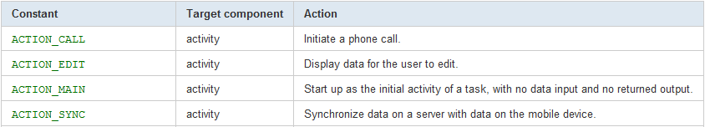
Action
The action to be performed
Examples:

Slide 5
Action (cont.)
Setting the Intent Action
new Intent(Intent.ACTION_VIEW);
Intent newInt = new Intent();
newInt.setAction(Intent.ACTION_VIEW);

Slide 6
Data
Data associated with the Intent
Formatted as a Uniform Resource Locator (URI)
Examples:
Data to view on a map
geo:0,0?q=1600+Pennsylvania+Ave +Washington+DC
Number to dial in the phone dialer
tel:+15555555555

Slide 7
Data (cont.)
Setting the Intent data
new Intent(Intent.ACTION_VIEW, Uri.parse("tel:+15555555555"));
Intent newInt = new Intent(Intent.ACTION_VIEW);
newInt.setData(Uri.parse("tel:+15555555555"));

Slide 8
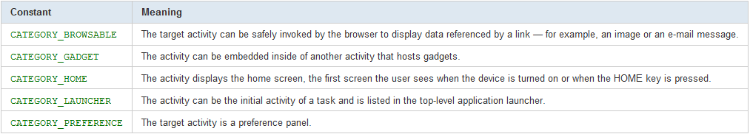
Category
Additional information about the components that handle the intent
Examples:

Slide 9
Type
Sets the MIME type of the Intent data
E.g., “image/*”
If unspecified, Android will infer the type
Setting the mime type
Intent.setType(String type)
Intent.setDataAndType(Uri data, String type)

Slide 10
Component
The component to receive this intent
Setting the component
Intent(Context packageContext, Class<?> cls);
Intent newInt = new Intent ();
newInt.setComponent(ComponentName) ;
newInt.setClass(Context, Class));

Slide 11
Extras
Additional information associated with Intent
Treated as key-value pairs
Setting the Extra attribute
Comes in several forms depending on data types involved, e.g.,
setExtra(String name, char value);

Slide 12
Extras (cont.)
EXTRA_EMAIL
email addresses to send an email message to
Intent newInt= new Intent(Intent.ACTION_SEND);
newInt.putExtra (
android.content.Intent.EXTRA_EMAIL,
new String[]{”aporter@cs.umd.edu"});

Slide 13
Flags
Specify how Intent should be handled
Examples:
FLAG_ACTIVITY_NO_HISTORY
Don’t put this Activity in the History stack
FLAG_DEBUG_LOG_RESOLUTION
Causes extra logging information to be printed when this Intent is processed

Slide 14
Flags (cont.)
Intent newInt= new Intent(Intent.ACTION_SEND);
newInt.setFlags(Intent.FLAG_ACTIVITY_NO_HISTORY);

Slide 15
Using Intents to Activate Activities
Intents are used to activate Activities
startActivity(Intent intent)
startActivityForResult(Intent intent, …)
The Activity to be activated can be
Named explicitly in the Intent, or
Can be determined through the intent resolution process

Slide 16
Explicit Activation
HelloWorldWithLogin
Users must authenticate before viewing the “Hello, Android” message
LoginActivity
Accepts username & password
If password correct, starts HelloAndroid Activity

Slide 17
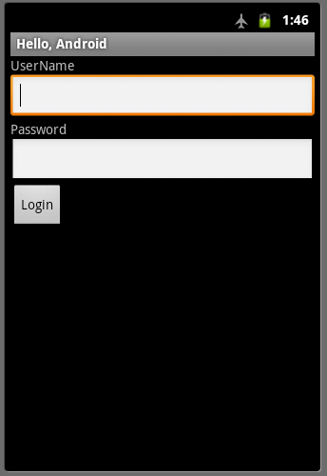
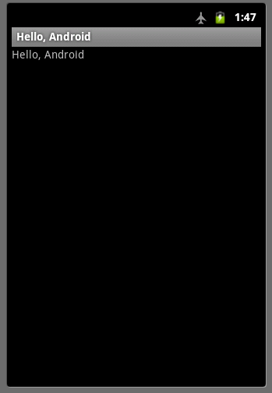
Activating an Activity (cont.)

Slide 18
Activating an Activity (cont.)
public class LoginScreen extends Activity {
public void onCreate(Bundle savedInstanceState) {
…
loginButton.setOnClickListener(new OnClickListener() {
public void onClick(View v) {
if (checkPassword(uname.getText(), passwd.getText())){
Intent helloAndroidIntent = new Intent(LoginScreen.this, HelloAndroid.class);
startActivity(helloAndroidIntent);
} }
});
}

Slide 19
Implicit Activation
When the Activity to be activated is not named, the system attempts to find an Activity that matches the Intent
Called Intent Resolution

Slide 20
Intent Resolution
A process for matching Intents with Activities that want to receive them
Intent Filters describe which Intents an Activity can handle
Usually specified in an AndroidManifest.xml file
Intent Resolution only considers the following
Action
Data (both URI and mime data type)
Category

Slide 21
Specifying IntentFilters in AndroidManifest.xml
<activity ….>
<intent-filter android:icon="drawable resource” android:label="string resource” android:priority="integer”
. . .
<action android:name=”actionName" />
…
</intent-filter>
…
</activity>

Slide 22
Specifying IntentFilters in AndroidManifest.xml
android:icon – Icon representing the activity
android:label - User-readable label for the parent component
android:priority – Priority given to the parent component when handling matching intents
Causes Android to prefer one activity over another
Higher values represent higher priorities

Slide 23
Adding data to an IntentFilter
<intent-filter …> …
<data android:host="string"
android:mimeType="string"
android:path="string"
android:pathPattern="string"
android:pathPrefix="string"
android:port="string"
android:scheme="string" /> …
</intent-filter>

Slide 24
Adding a Category to an IntentFilter
<intent-filter …> . . .
<category android:name="string" /> …
</intent-filter>

Slide 25
Example: Map Application
<intent-filter …> <action android:name=
"android.intent.action.VIEW" /> <category android:name= "android.intent.category.DEFAULT" /> <category android:name= "android.intent.category.BROWSABLE" /> <data android:scheme="geo”/>
<intent-filter>

Slide 26
CheckIntents
public class CheckIntents extends Activity { … public void onCreate(Bundle savedInstanceState) { … checkButton.setOnClickListener(new OnClickListener() {
public void onClick(View v) {
List<String> acts = CheckIntents.getActivitiesForAction(
CheckIntents.this, intentText.getText().toString()) // output results
}
});
}

Slide 27
CheckIntents
public static List<String> getActivitiesForAction( Context context,String action) {
final PackageManager packageManager = context.getPackageManager();
final Intent intent = new Intent(action);
final List<ResolveInfo> list = packageManager.queryIntentActivities(intent, 0);
final List<String> acts = new ArrayList<String>();
for (ResolveInfo ri : list) { acts.add(ri.activityInfo.name); }
return acts;
}
…

